Slide 1
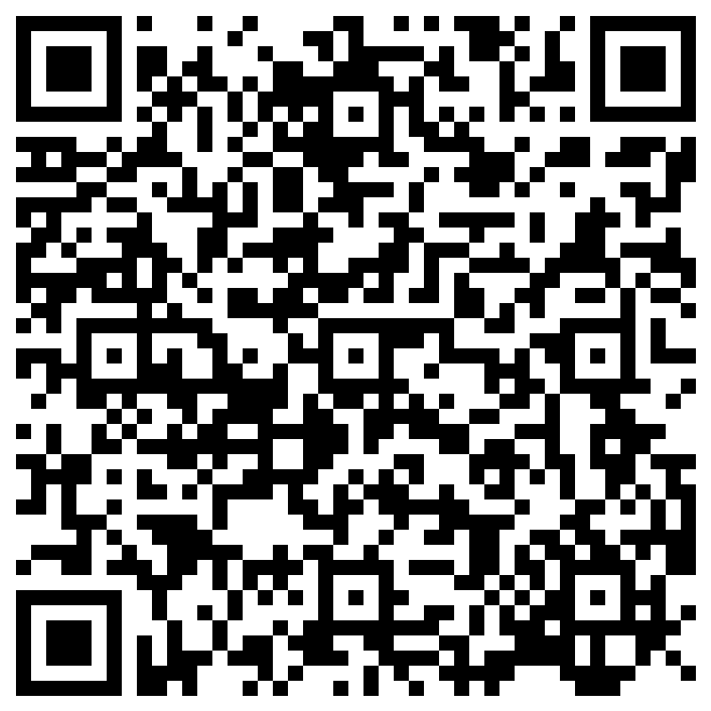
Welcome Back NHS Seniors! 2023-2024 School Year
ATTENDANCE LINK:

Slide 2
E-Board/Contact Information
President: Luca Polidori
Email: 1760004257@cvs.k12.mi.us
Vice President: Patrick Swieczkowski
Email: 1760004014@cvs.k12.mi.us
Secretary: McKenna Koneval
Email: 1760002948@cvs.k12.mi.us
Treasurer: Karen Mei
Email: 1760003761@cvs.k12.mi.us
Parliamentarian: Cody Shene
Email: 1760004036@cvs.k12.mi.us
Probation Officer: Eemi Toma
Email: 1760021626@cvs.k12.mi.us
Probation Officer: Fatimah Beni-Lam
Email: 1760018487@cvs.k12.mi.us

Slide 3
Hour Requirements
Every member is required to get 40 service hours; it is your own responsibility to keep track of your hours
10 summer hours were required; these count towards the 40 total
No more than 10 hours can be counted from one event
More than 10 summer hours can be counted towards the total, as long as they came from different events
There is no limit on the number of outside hours you can do, as long as they are approved
There is also no limit on hours from tutoring, but it must be done through NHS

Slide 4
Outside Hours
Outside hours must benefit the community as a whole
To do outside hours, you must fill out the form below to get your request approved
https://docs.google.com/forms/d/e/1FAIpQLSeX0adVMmAfSypuO4KJGjV4seJlCf6Bl1T8GJApPUhnljYrwQ/viewform
The form must be submitted at least 5 days before the requested event
Check your school email for approval before working the event/counting the hours- If the event is not approved the hours will not be counted
Before filling out a request form, check to make sure your event is not already on the preapproved list on the website

Slide 5
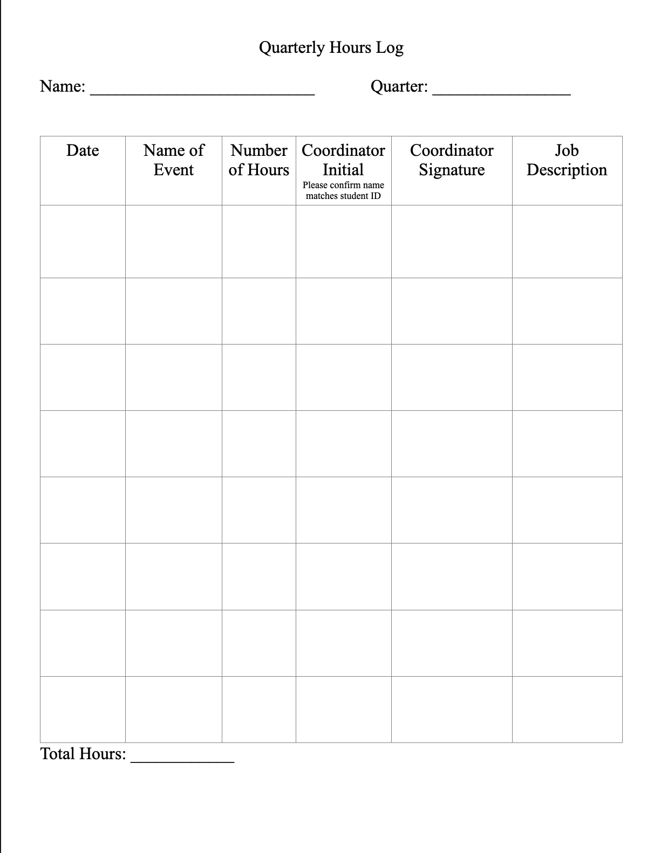
Logging/Submitting Hours
Hour logs can be found on the website and printed
At the end of each quarter, you will take a picture of your log and email it to DakotaHighSchoolNHS@gmail.com

Slide 6
BAND
All hour opportunity/event signups will be posted on BAND, along with important reminders.
If you sign up for an event that you are not able to attend, you must find someone to take your spot. This is done by making a post on BAND.
If you no show an event you sign up for, you will be docked the amount of hours of the event and put on probation
Invite Code: 2382 FEE

Slide 7
Remind
We will use Remind to send out reminders for hour deadlines, meeting dates/times, and any other important information that may come up
Senior Remind: Text @fcke24 to 810-10

Slide 8
Website
Our website can be found at https://dakotanhs.weebly.com
The website contains a lot of important things like copies of powerpoints from meetings, printable hour logs, the approved outside hour list, the outside hour request form, meeting dates, contact information, and more

Slide 9
Instagram
Instagram will be another platform for important updates
Our Instagram is @dakota_nhs

Slide 10
Dues
Dues this year are $15
The fee is assigned to you in PaySchools already.

Slide 11
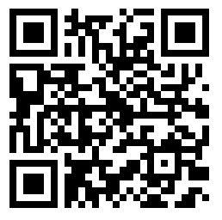
Shirts + Apparel
NHS shirts/apparel must be worn to ALL events unless otherwise stated or given a specific dress code
You are not required to buy additional items if you already have some
Scan the QR code for the link to the store and the link will be posted in BAND

Slide 12
Meeting Dates
September 12 ​
October-Induction​
November 14​
December 5​
January 9​
February 6​
March 5​
May 14
June 4

Slide 13
Probation
Members are required to attend every meeting
Absence at a meeting will result in probation
If you can not attend a meeting, email our secretary, (1760002948@cvs.k12.mi.us) in advance to qualify for an excused absence.
Not attending an event you signed up for will also result in probation. You will be docked the amount of hours of the event as well.
You will receive an email from a probation officer letting you know you are on probation
Once on probation, you do not come off and can not miss any more meetings

Slide 14
In Conclusion..
Make sure you're in the BAND
1
Join Remind
2
Follow our Instagram
3
Make sure you take care of your dues in PaySchools
4
Have a good rest of your day
5

